Slide 1
Chapter 5: Decision Making and Branching

Slide 2
Introduction
“Decision making” is one of the most important concepts of computer programming.
Generally C program executes its statements sequentially. But in order to solve problems we may have some situations where we have to change the order of executing the statements based on whether some conditions have met or not.
So controlling the execution of statements based on certain condition or decision is called decision making statements.
They are also called control statements as they ‘control’ the flow of execution.

Slide 3
Introduction – Branching
“Branching” is a process where the set of statements are selected for execution based on the condition met. If the condition is not met, then the set of statements will be ignored completely.

Slide 4
START
Read User Input
Making Decision
Condition?
Condition Satisfied
[True]
Condition not Satisfied
[False]
Branching
Perform Some Tasks
Perform Some Other Tasks
Branch 1
Branch 2
Show Result
END

Slide 5
Decision Making & Branching in C
C language possesses decision making and branching capabilities by supporting the following statements:
      if statement
      switch statement
      Conditional operator statement (?:)
      goto statement

Slide 6
if Statement
It is basically a two-way decision-making statement and is used in conjunction with an expression. It takes the following structure:
if (test-condition)
It allows the computer to evaluate the expression first and then depending on whether the value of the expression or condition is true or false, it transfer the control to a particular statement.
The program has two paths to follow, one for the true condition and the other for the false condition.

Slide 7
if Statement
Entry
Test Condition ?
False
True
Example:
if(age>=0)
bonus=bonus+2000;

Slide 8
if Statement
The if statement can be implemented if four different forms depending on the complexity of the conditions to be tested. The four forms are:
      Simple if statement
      if else statement
      Nested if else statement
      else if ladder

Slide 9
Simple if Statement- Structure
The general form of a simple if statement is:
if (test_condition)
{
statement-block;
}
statement x;

Slide 10
Simple if Statement
The statement block may consist of a single statement or a group of statements.
If the test_condition is satisfied, then the statement-block will be executed first then the statement-x will be executed after completing the execution of statement block.
Otherwise, if the test_condition is not satisfied then, the statement- block will be skipped and the execution will jump to the statement-x.
When the condition is true then both the statement block and the statement-x are executed but in sequence.

Slide 11
Simple if Statement- Flowchart
Entry
test
expression
?
True
statement-block
False
statement - x
Next statement

Slide 12
Simple if Statement-Example
Example with block of statements:
if (marks>=90) //marks = 85, bonus_marks = 2, grade = A+
{
marks = marks + bonus_marks;
grade=“A+”;
}
printf(“The mark achieved: %d” , marks); // output - 85

Slide 13
Simple if Statement
What happens if multiple statements follows the if condition without enclosed in curly braces?
Answer: Then the statement immediately following the if condition is considered as the controlling statement of the if condition. if the condition is true the controlled statement is executed otherwise not. Rest of the statements are executed sequentially.

Slide 14
Simple if Statement
Example:
if (marks>=90) //marks = 85, grade = A+
marks=marks+ bonus_marks;
grade=“A+”;
printf(“Marks =%d and grade = %c ” , marks, grade);
_____________________________________________
if (marks>=90){ //marks = 85, grade = A+
marks=marks+ bonus_marks;
grade=“A+”;
}
printf(“Marks =%d and grade = %c ” , marks, grade);

Slide 15
if else Statement
If the test condition is true then the statements within the body of if are executed;
Otherwise, the statements within the body of else are executed.
In short either true-block or false-block of statements will be executed, not both.
But in both cases the control is transferred subsequently to the statement-x as it is an independent (not controlled by the if else statement) statement.
It is also called two-way conditional branching

Slide 16
if else Statement- Structure
The if else statement is an extension of the simple if statement. The general form is :
if (test_condition)
{
True block statements;
}
else
{
False block statements;
}
statement-x;

Slide 17
if else Statement- Flowchart
Entry
[ False ]
Test_Condition ?
[ True ]
False Statement-block;
True Statement-block;
Statement-X;
Next Statement;

Slide 18
if else Statement- Example
Example with block of statement:
if (marks>=40)
{
marks=marks+ bonus_marks;
grade=“passed”;
}
else
{
marks=marks;
grade=“failed”;
}
printf(“The mark achieved: %d ” , marks);
True block statement
False block statement

Slide 19
Nested if else Statement
Using “if…else statement” within another “if…else statement” is called ‘nested if statement’. “Nested if statements” is mainly used to test multiple conditions.
It is called nested conditional branching.
They can be structured using following syntax:

Slide 20
Nested if else Statement- Structure
if (test_condition)
{
if (test_condition)
{
statement-block;
}
else
{
statement-block;
}
}
else
{
statement-block;
}
statement-x;
Nested if else

Slide 21
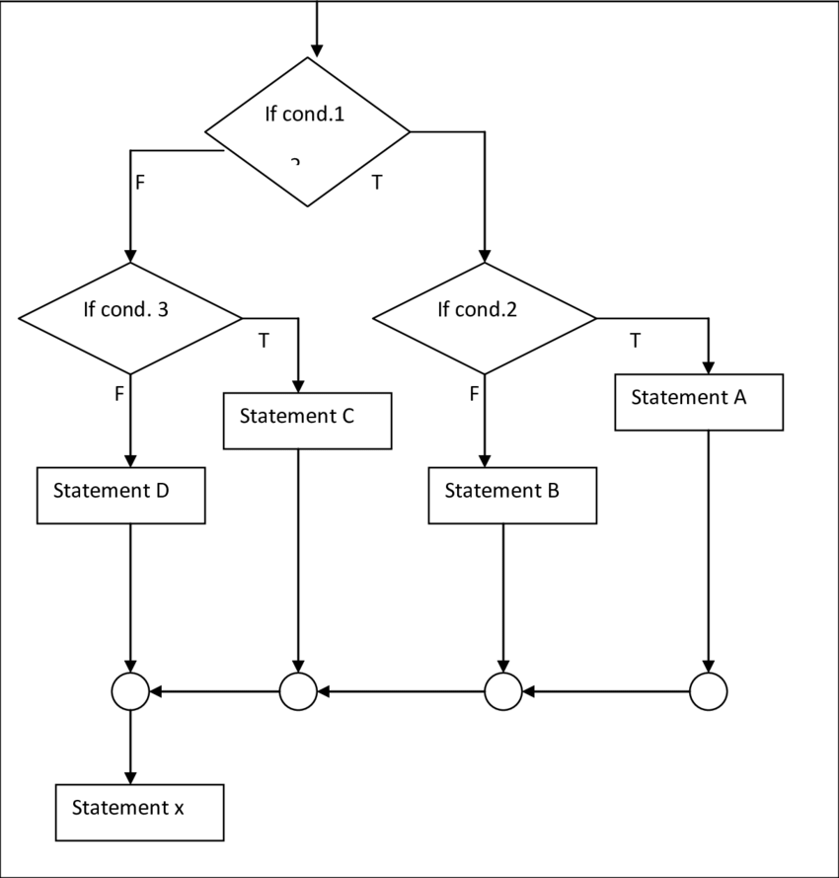
Nested if else Statement- Structure

Slide 22
Nested if else -Example
if (a>b)
{
if (a>c)
max = a;
else
max = c;
}
else
{
if (b>c)
max=b;
else
max=c;
}
printf(“Max=%d”,max);
a = 5, b = 10, c = 15
Max = 15
a = 20, b = 10, c = 15
Max = 20
a = 20, b = 10, c = 30
Max = 30

Slide 23
Dangling else Problem
Dangling else problem occurs when you have multiple if statement and fewer else clause in a given program.
For eg:
Solutions: Compiler always associates else to nearest if.
if (10<5) if (10>2) printf(“ABC”); else printf(“XYZ”); | if (10<5) if (10>2) printf(“ABC”); else printf(“XYZ”);
if (10<5){ if (10>2){ printf(“ABC”); } } else{ printf(“XYZ”); } | ?

Slide 24
else if ladder Statement
As the name implies this statement is used to choose right way/paths among multiple paths.
There is another way of putting if conditions together when multiway decisions are involved.
A multiway decision is a chain of if conditions in which the statement associated with an else condition behaves like another if condition.
else if ladder is also called multiway decision making statement.

Slide 25
Else if ladder- Structure
if (test_condition 1)
statement-1;
else if (test_condition 2)
statement-2;
else if (test_condition 3)
statement-3;
else if (test_condition 4)
statement-4;
…………………………………..
else if (test_condition n)
statement-n;
else
statement-x;

Slide 26
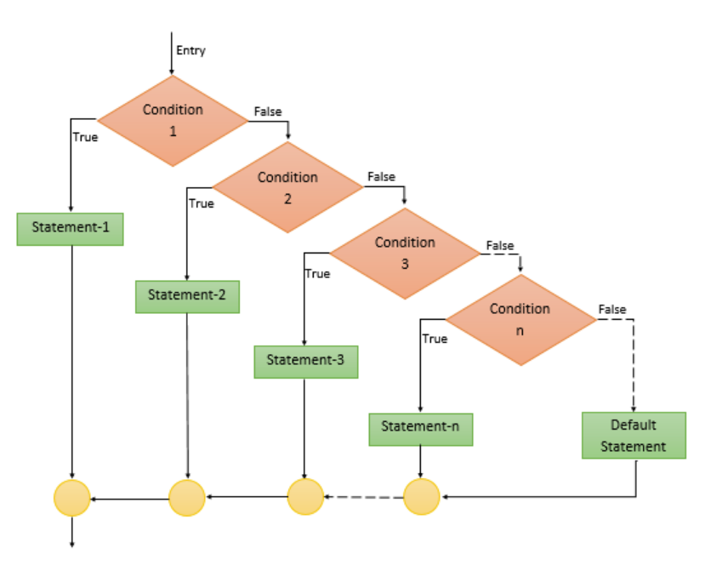
Else if ladder- Flowchart

Slide 27
Else if ladder- Example
if(Mark>=50 && Mark<60)
printf("Your grade is D");
else if(Mark>=60 && Mark<70)
printf("Your grade is C \n");
else if(Mark>=70 && Mark<80)
printf("Your grade is B \n");
else if(Mark>=80 && Mark<=100)
printf("Your grade is A \n");
else
printf("you have failed");

Slide 28
Switch Statement
The switch statement tests the value of a given variable or expression against a list of case values and when a match is found only then a block of statements associated with that case is executed.
The expression used in switch statement must result in integer or character.

Slide 29
Switch Statement-Structure
switch(expression/ value)
{
case value-1:
statement-block-1;
break;
case value-2:
statement-block-2;
break;
……………………….
case value-n:
statement-block-n;
break;
default:
default-statement-block;
break;
}
statement-x;

Slide 30
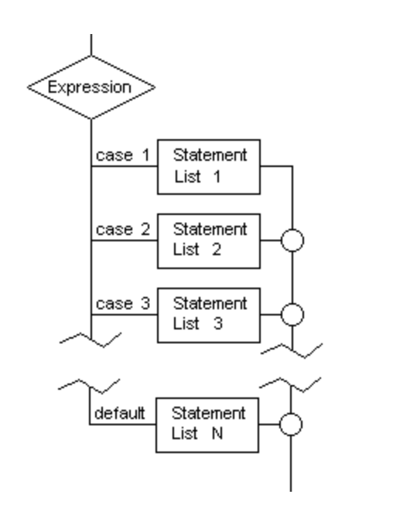
Switch Statement-Flowchart

Slide 31
Switch Case Example
Grade Assignment Problem:
marks | Grade | Index= marks/10
90-100 | S | 9, 10
80-89 | A | 8
70-79 | B | 7
60-69 | C | 6
50-59 | D | 5
40-49 | E | 4
<40 | F | 0,1,2,3

Slide 32
Switch Case Example
Grade Assignment Problem:
index= marks/10;
switch(index) { switch(marks/10)
case 10:
case 9: grade=‘s’; break;
case 8: grade=‘a’; break;
case 7: grade=‘b’; break;
case 6: grade=‘c’; break;
case 5: grade=‘d’; break;
case 4: grade=‘e’; break;
default: grade=‘f’; break;
}
Printf(“Grade: %c”,grade);

Slide 33
Rules for Switch Statement
The switch statement must be an integral type.
Case labels must be constant or constant expression.
Case labels must be unique. No two labels can have the same value.
Case labels must end with colon.
The break statement transfers the control out of the switch statement.
The break statement is optional. Two or more case labels may belong to the same statements.
The default label is optional. If present, it will be executed when the expression does not find a matching case label.
There can be at most one default label.
The default may be placed any where but usually placed at the end.
It is permitted to nested switch statements.

Slide 34
Conditional Operator
The conditional operator useful for making two-way decisions.
This operator is a combination of ? and : and it takes three operands.
The conditional operator can be used as the replacement of if else conditional statement for two-way decision making.

Slide 35
Conditional Operator
The general structure of conditional operator:
Conditional expression? true-statement : false-statement;
The condition is evaluated first. If the result is true, then the statement 1 is executed and its value is returned.
Otherwise, false-statement is executed and its value is returned.
Example:
flag = (x<0) ? 0 :1;

Slide 36
Conditional Operator
Conditional operator:
flag = (x<0) ? 0 :1;
It is equivalent to:
if(x<0)
flag=0;
else
flag=1;

Slide 37
goto statement
goto is an unconditional branch statement in C.
Syntax:
goto label;
where label is symbolic name assigned to any instruction in the given program.
Depending upon the location of the instruction goto statement can be considered as
  Forward goto (forward jump) – facilitates branch in program.
  Backward goto (backward jump) – facilitates loop in program.

Slide 38
goto statement
Forward goto (forward jump) | Backward goto (backward jump)
Syntax: inst 1; inst 2; goto label1; inst 4; inst 5; label1: inst 6; inst 7; | Syntax: Inst 1; inst 2; label2: inst 3; inst 4; inst 5; goto label2; inst 7;
Instruction 4 and 5 are never selected for execution. Compiler may show instruction 4 and 5 as unreachable code. | Instruction 3, 4 and 5 are selected for repeated execution and the program enters into infinite loop.
Therefore, goto statements are executed with if statements generally. Further, Use of goto makes the program unstructured, therefore,it is advised not to use goto statement in good programming practices.

Slide 39
goto statement
Forward goto (forward jump) | Backward goto (backward jump)
Syntax: inst 1; inst 2; if(cond) goto label1; inst 4; inst 5; label1: inst 6; inst 7; | Syntax: Inst 1; inst 2; label2: inst 3; inst 4; inst 5; if (cond) goto label2; inst 7;

